Slide 1

Unit-1 Introduction to Basic Java Programming
Object-Oriented Programming using Java
#2104CS203
Prof. Devangi L. Kotak
Darshan Institute Computer Application
devangi.kotak@darshan.ac.in

Slide 2
Introduction
Welcome to the world of Programming

Slide 3

What is Language?
A language is a system of communication used by a particular country or community.
It is a structured system of communication used by humans, based on speech and gesture (spoken language), sign or often writing.
Both person should understand each other’s language.
Hello!
કેમ છો!
你好
મજામાં

Slide 4

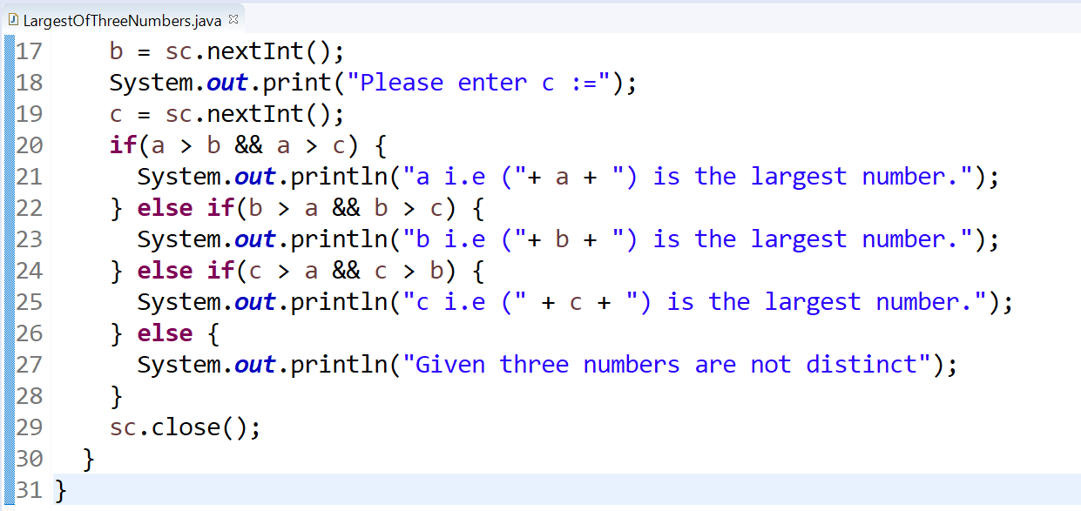
Programming Language
A programming language is a computer language that is used by programmers (developers) to communicate with computers.
It is a set of instructions written in a specific language to perform a specific task.
It allow us to give instructions to a computer in a language the computer understands.
5000+ programming languages are there, notably used are approximate 250.
E.g. C, C++, C#, Java, Python, PHP, Pascal, etc.

Slide 5
Types of Programming Languages
Low-level programming language
It is a machine-dependent (hardware specific) programming language.
It consists of a set of instructions that are either in the binary form (0 or 1) or in a symbolic and human-understandable mnemonics (ADD, MOV, SUB).
E.g. Machine level language, Assembly language, etc.
High-level programming language
It is closer to human languages than machine-level languages.
It is easy to read, write, and maintain as it is written in English like words.
It allows to write the programs which are independent of a particular type of machine (hardware).
A compiler is required to translate a high-level language into a low-level language.
E.g. Python, Java, JavaScript, PHP, C#, LISP, FORTRAN, etc.
Middle-level programming language
Middle-level programming language lies between the low-level and high-level programming language.
E.g. C, C++, etc.

Slide 6



Slide 7

Introduction to

Slide 8
JAVA
Java is a general-purpose computer-programming language that is:
Open source
Platform independent
Object-oriented and
To have as few implementation dependencies as possible.
Java was originally developed by James Gosling at Sun Microsystems and released in 1995.
Java was initially named as Oak language and renamed to JAVA in 1995.
In 2010 Oracle company has acquired Sun microsystem, which is origin of java.
Current Version | Java SE 19.0. 1 (as of September, 14th 2021)
Version we will use | Java SE 11 (LTS)
Setup size | 149 MB (Linux), 152 MB (Windows x64)
Download Link | https://www.oracle.com/in/java/technologies/javase-jdk11-downloads.html
Official Website | https://java.com
Integrated Development Environment (IDE) | Eclipse NetBeans IntelliJ IDEA Community Edition BlueJ

Slide 9
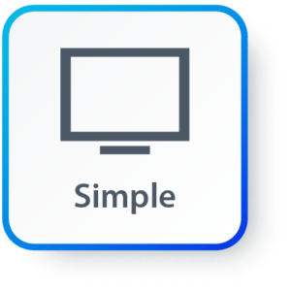
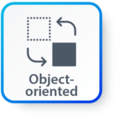
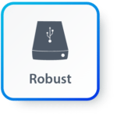

Features of JAVA
Simple: Java is very easy to learn, and its syntax is simple, clean and easy to understand. Java inherits C/C++ syntax and many object-oriented features of C++.
Object Oriented: “Everything is an object” model, which have some state, behavior and all the operations are performed using these objects.
Robust: Java has a strong memory management system. It helps in eliminating error as it checks the code during compile and runtime.
Multithreaded: Java supports multiple threads of execution, including a set of synchronization primitives. This makes programming with threads much easier.

Slide 10



Features of JAVA (Cont.)
Architectural Neutral/Portable: Java is platform independent which means that any application written on one platform can be easily ported to another platform.
Interpreted: Java is compiled to bytecodes, which are interpreted by a Java run-time environment.
High Performance: Java achieves high performance through the use of bytecode which can be easily translated into native machine code. With the use of JIT (Just-In-Time) compilers, Java enables high performance.

Slide 11

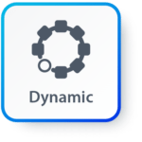
Features of JAVA (Cont.)
Distributed: Java provides a feature which helps to create distributed applications. Using Remote Method Invocation (RMI), a program can invoke a method of another program across a network and get the output. You can access files by calling the methods from any machine on the internet.
Dynamic: Java has ability to adapt to an evolving environment which supports dynamic memory allocation due to which memory wastage is reduced and performance of the application is increased.

Slide 12
Components of Java
Java Virtual Machine (JVM)
Java Runtime Environment (JRE)
Java Development Kit (JDK)
JDK
Compiler (javac.exe)
Java Application
Launcher (java.exe), AppletViewer, etc..)
Java Packages
(math, util, awt etc…)
JVM
Runtime Libraries
Development tools
JRE

Slide 13
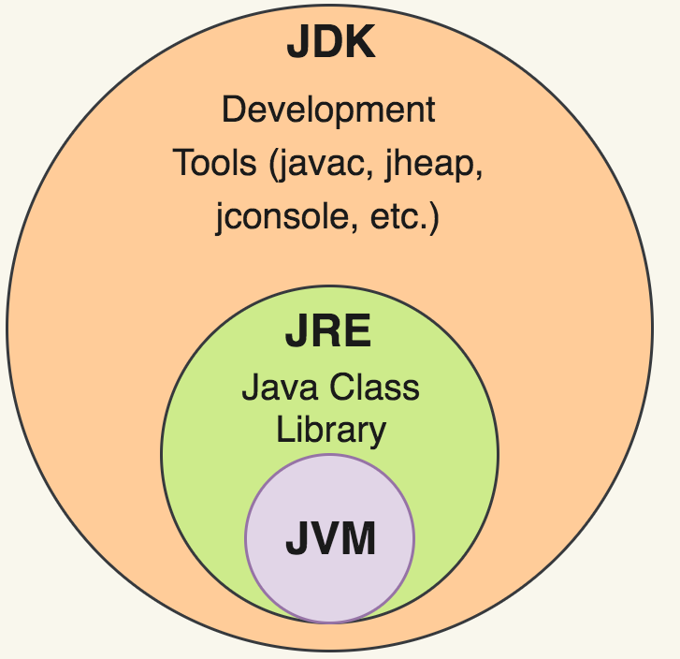
Java Development Kit (JDK)
JDK contains tools needed ,
To develop the Java programs and
JRE to run the programs.
The tools include
compiler (javac.exe),
Java application launcher (java.exe),
Appletviewer, etc…
Java application launcher (java.exe) opens a JRE, loads the class, and invokes its main method.

Slide 14
Java Runtime Environment (JRE)
The JRE is required to run java applications.
It combines the Java Virtual Machine (JVM) platform core classes and supporting libraries.
JRE is part of the Java Development Kit (JDK), but can be downloaded separately.
It does not contain any development tools such as compiler, debugger, etc.

Slide 15
Java Virtual Machine (JVM)
JVM is a virtual machine that enables a computer to run Java programs which is compiled to Java Bytecode.
Byte code is intermediate representation of java source code.
Bytecode is a highly optimized set of instructions designed to be executed by the Java Virtual Machine(JVM).
Java compiler provides byte code by compiling Java Source Code.
Extension for java class file or byte code is ‘.class’, which is platform independent.
JVM is virtual because, It provides a machine interface that does not depend on the operating system and machine hardware architecture.
JVM interprets the byte code into the machine code.
JVM itself is platform dependent, but Java is Not.

Slide 16
How Java become Platform Independent?
Source code (Program)
.java file
Compiler
Bytecode
.class file
JVM
(Windows)
JVM
(Linux)
JVM
(Mac)
Machine Code
Machine Code
Machine Code

Slide 17
Java Interview Question
Difference between JRE and JVM?
Why Java is platform independent?
What are Java bytecodes?
JVM vs. JRE vs. JDK

Slide 18
Hello World Java Program
File must be saved as HelloWorld.java
public class HelloWorld
{
public static void main(String[] args)
{
System.out.println("Hello World");
}
}
We have to save this in HelloWorld.java file as it has public class named HelloWorld.
String and System are inbuilt Java Classes.
Classes in java are always written in Camel case.
Main method from where execution will start
String must start with capital letter
System must start with capital letter

Slide 19
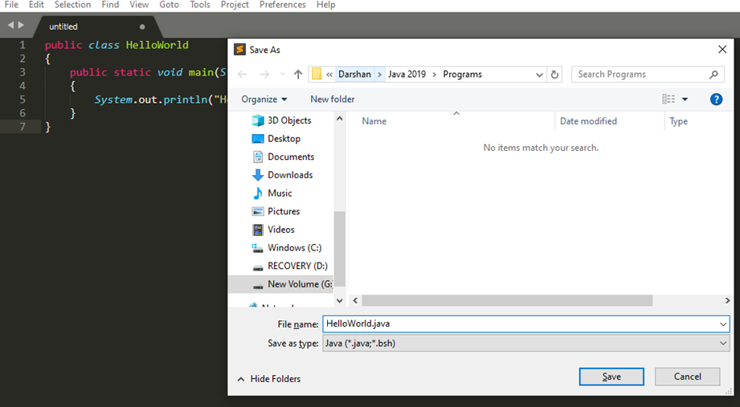
How to execute Java Program?
Save the program with the same name as the public class with .java extension.

Slide 20
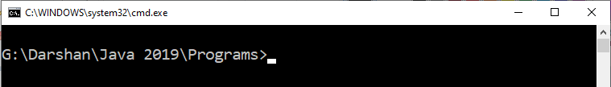
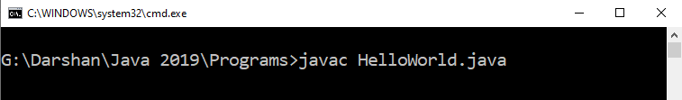
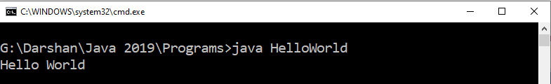
How to execute Java Program?
Open command prompt (cmd) / terminal & navigate to desired directory / folder.
Compile the “.java” file with javac command.
Execute the “.class” file with java command without extension.

Slide 21
Identifiers
Identifiers are used for class names, method names, variable names and more.
An identifier may be any descriptive sequence of
uppercase(A…Z) and lowercase(a..z) letters
Numbers(0..9)
Underscore(_) and dollar-sign($) characters
Rules for Identifiers (other than above mention point)
There should not be any space in an identifier. For example, darshan uni is an invalid identifier.
An identifier should not contain a number at the starting. For example, 123darshan is an invalid identifier.
We can't use the Java reserved keywords as an identifier such as int, float, double, char, etc. For example, int double is an invalid identifier in Java.

Slide 22
Identifiers
Examples for valid Identifiers,
AvgTemp
count
a4
$test
this_is_ok
Examples for invalid Identifiers,
2count
High-temp
Ok/NotOK

Slide 23
Data Types
Java Datatypes
Primitive
Non-primitive
Integers
Floating-point numbers
Characters
Boolean
Class

Slide 24
Primitive Data Types
Data Type | Size | Range | Example
byte | 1 Byte | -128 to 127 | byte a = 10;
short | 2 Bytes | -32,768 to 32,767 | short a = 200;
int | 4 Bytes | -2,147,483,648 to 2,147,483,647 | int a = 50000;
long | 8 Bytes | -9,223,372,036,854,775,808 to 9,223,372,036,854,775,807 | long a = 20;
float | 4 Bytes | 1.4e-045 to 3.4e+038 | float a = 10.2f;
double | 8 Bytes | 4.9e-324 to 1.8e+308 | double a = 10.2;
char | 2 Bytes | 0 to 65536 (Stores ASCII of character) | char a = ‘a’;
boolean | Not defined | true or false | boolean a = true;

Slide 25
Escape Sequences
Escape sequences in general are used to signal an alternative interpretation of a series of characters.
For example, if you want to put quotes within quotes you must use the escape sequence, \", on the interior quotes.
System.out.println("Good Morning \"World\“ ");
Output: Good Morning “world”
Escape Sequence | Description
\’ | Single quote
\” | Double quote
\\ | Backslash
\r | Carriage return
\n | New Line
\t | Tab

Slide 26
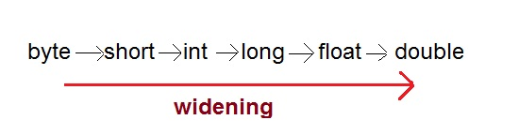
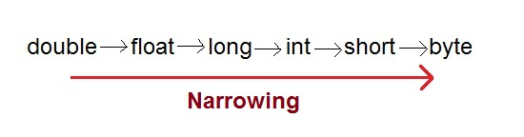
Type Casting
Assigning a value of one type to a variable of another type is known as Type Casting.
In Java, type casting is classified into two types,
Widening/Automatic Type Casting (Implicit)
Narrowing Type Casting(Explicitly done)

Slide 27
Widening conversion
When one type of data is assigned to other type of variable , an automatic type conversion will take place if the following two conditions are satisfied:
The two types are compatible
The destination type is larger than the source type
Such type of casting is called “widening conversion”.
Example:
int can always hold values of byte and short
For example, in java, the numeric data types are compatible with each other
But no automatic conversion is supported from numeric type to char or boolean.
Also, char and boolean are not compatible with each other.
public static void main(String[] args) {
byte b = 5;
int a = b; // √ this is correct
}

Slide 28
Narrowing conversion
To create a conversion between two incompatible types and conversion from larger to small type, you must use a explicit type conversion which is done by programmer.
Incompatible types are int to char, int to Boolean, char to boolean
Such type is called as “narrowing conversion”.
Syntax:
(target-type) value
Example:
public static void main(String[] args)
{
char ch;
int num = 88;
ch = (char)num;
System.out.println("ch="+ch);
}

Slide 29
Type Promotion in Expressions
In arithmetic expression sometime needs to do such type of automatic type conversion.
That is called as Automatic Type Promotion in Expressions.
For example, examine the following expression:
The result of the intermediate term a * b easily exceeds the range of byte operands.
To handle this kind of problem, Java automatically promotes each byte, short, or char operand to int when evaluating an expression.
This means that the subexpression a*b is performed using integers—not bytes.
public static void main(String[] args)
{
byte a=40, b=50, c=100;
int d= a*b/c;
}

Slide 30
Automatic type promotions and compile-time errors
Automatic type promotions can cause confusing compile-time errors.
For example, this seemingly correct code causes a problem:
Because the operands were automatically promoted to int when the expression was evaluated, we should use an explicit cast.
public static void main(String[ ] args)
{
byte b=5;
b=b*2; //Error! can not assign int to byte
}
public static void main(String[ ] args)
{
byte b=5;
b=(byte) b*2;
System.out.println(“b=“+b);
}

Slide 31
Command line arguments
Command Line Argument in Java is the information that is passed to the program when it is executed.
The information passed is stored in the string array(String args[ ]) passed to the main() method.
It is stored as a string.
It is the information that directly follows the program’s name on the command line when it is running.
For example: While running a class Demo, you can specify command line arguments as:
F:>java>program>
F:>java>program>
java Demo hello DU
Stored in args[0]
Stored in args[1]
Class Demo
{
public static void main(String args[ ])
{
System.out.println(“arg one=“+args[0]);
System.out.println(“arg two=“+args[1]);
}
}
Output:
arg one= hello
arg two= DU

Slide 32
PARSE method
PARSE : It is a method which take a string(input) as an argument and convert in other formats as like :
Integer
Float
Double
The functions of parse methods :
parseInt(); - It is a member function in Integer Class;
parseDouble(); – It is a member function in Double Class;
parseFloat(); – It is a member function in Float Class;
How to use?:
Syntax: Integer.parseInt(String s);
Float.parseFloat(String s);
Double.parseDouble(String s);

Slide 33
PARSE method example
Example : 1
String s=”156″; //156 is not a number it is string;
System.out.println(s+1); //output:1561 (Because ”156″+1=1561 string concatenation).
int x=Integer.parseInt(“156”);
System.out.println(x+1); //output:157 (Because 156+1=157)
Example : 2
String s=”156.5″; //156.5 is not a number it is a string;
System.out.println(s+1); //output:156.51 (Because ”156.5″+1=156.51 string concertation)
double x=Double.parseDouble(“156.5”);
System.out.println(x+1); //output:157.5 (Because 156.5+1=157.5)

Slide 34
Example: Parse for command line argument
Example program# 1 : ( Without Parse )
Example program # 2: ( With Parse ) :
public class Demo
{
public static void main(String args[ ])
{
System.out.println(args[0]+1);
System.out.println(args[1]+1);
}
}
compile: javac Demo.java
run: java Demo 10 20
Output:
101
201
public class Demo {
public static void main(String args[ ])
{
int a=Integer.parseInt(args[0]);
int b=Integer.parseInt(args[1]);
System.out.println(a+1);
System.out.println(b+1);
}
}
compile: javac Demo.java
run: java Demo 10 20
Output:
11
21

Slide 35
Java Scanner Class
Java Scanner class allows the user to take input from keyboard and monitor.
It belongs to java.util package.
It is used to read the input of primitive types like int, double, long, short, float, and byte.
Syntax: Scanner sc=new Scanner(System.in);
This way we are creating object of scanner class.
So using object and methods of scanner class we can get input from user and use it in our program.

Slide 36
Methods of Java Scanner Class
Java Scanner class provides the following methods to read different primitives types:
Method | Description
nextInt() | Read the input as an integer.
nextFloat() | Read the input as a float.
nextDouble() | Read the input as a double.
nextByte() | Read the input as a byte.
nextLine() | Read whole line.
next() | Read one word.
nextBoolean() | Read the input into a boolean value.
nextLong() | Read the input as a long.
nextShort() | Read the input as a short.

Slide 37
Java program to get integer from user
import java.util.Scanner;
public class UserInputDemo
{
public static void main(String[] args)
{
Scanner sc= new Scanner(System.in); //System.in is a standard input stream
System.out.print("Enter first number- ");
int a= sc.nextInt();
System.out.print("Entered number is:”+a);
}
}

Slide 38
Java program to read data of various types using Scanner class
import java.util.Scanner;
public class UserInputDemo
{
public static void main(String[] args)
{
Scanner sc= new Scanner(System.in); //System.in is a standard input stream
String name = sc.nextLine();
char gender=sc.next().charAt(0);
int age=sc.nextInt();
long mobileNo=sc.nextLong();
double CGPA=sc.nextDouble();
System.out.println(“Name: ”+name);
System.out.println(“Gender: ”+gender);
System.out.println(“Age: ”+age);
System.out.println(“Mobile No: ”+mobileNo);
System.out.println(“CGPA: ”+CGPA);
}
}

Slide 39
Operators
Arithmetic Operators
Relational Operators
Bitwise Operators
Logical Operators
Assignment Operators
Conditional / Ternary Operator
Instance of Operator

Slide 40
Arithmetic Operator
Note : A = 10 & B = 20
Operator | Description | Example
+ | Addition | A + B = 30
- | Subtraction | A - B = -10
* | Multiplication | A * B = 200
/ | Division | B / A = 2
% | Modulus | B % A = 0
++ | Increment | B++ = 21
-- | Decrement | B-- = 19

Slide 41
Relational Operators
Note : A = 10 & B = 20
Operator | Description | Example
== | Equals | (A == B) is not true.
!= | Not Equals | (A != B) is true.
> | Greater than | (A > B) is not true.
< | Less than | (A < B) is true.
>= | Greater than equals | (A >= B) is not true.
<= | Less than equals | (A <= B) is true.

Slide 42
Bitwise Operators
Note : A = 60 & B = 13
Operator | Description | Example
& | Binary AND Operator | A & B = 12 which is 0000 1100
| | Binary OR Operator | A | B = 61 which is 0011 1101
^ | Binary XOR Operator | A ^ B = 49 which is 0011 0001
~ | Binary Ones Complement Operator | ~A = -61 which is 1100 0011 in 2's complement form due to a signed binary number.
<< | Binary Left Shift Operator | A << 2 = 240 which is 1111 0000
>> | Binary Right Shift Operator. | A >> 2 = 15 which is 1111
>>> | Shift right zero fill operator. | A >>>2 = 15 which is 0000 1111

Slide 43
Logical Operators
Note : A = true & B = false
Operator | Description | Example
&& | Logical AND operator | (A && B) is false.
|| | Called Logical OR Operator | (A || B) is true.
! | Called Logical NOT Operator | !(A && B) is true.

Slide 44
Assignment Operators
Operator | Description | Example
= | Simple assignment operator | C = A + B will assign value of A + B into C
+= | Add AND assignment operator | C += A is equivalent to C = C + A
-= | Subtract AND assignment operator | C -= A is equivalent to C = C - A
*= | Multiply AND assignment operator | C *= A is equivalent to C = C * A
/= | Divide AND assignment operator | C /= A is equivalent to C = C / A
%= | Modulus AND assignment operator | C %= A is equivalent to C = C % A
<<= | Left shift AND assignment operator | C <<= 2 is same as C = C << 2
>>= | Right shift AND assignment operator | C >>= 2 is same as C = C >> 2
&= | Bitwise AND assignment operator | C &= 2 is same as C = C & 2
^= | bitwise exclusive OR and assignment operator | C ^= 2 is same as C = C ^ 2
|= | bitwise inclusive OR and assignment operator | C |= 2 is same as C = C | 2

Slide 45
Conditional Operator (Ternary)
Conditional Operator ( ? : )
Syntax:
variable x = (expression) ? value1 (if true) : value2 (if false)
Example:
b = (a == 1) ? 20 : 30;

Slide 46
Operator Precedence & Associativity
How does java evaluate 1 + 10 * 9 ?
(1 + 10 ) * 9 = 99 OR 1 + (10 * 9) = 91
To get the correct answer for the given problem Java came up with Operator precedence.
here multiplication have higher precedence than addition so correct answer will be 91 in this case.
For Operator, associativity means that when the same operator appears in a row, then to which direction the expression will be evaluated.
How does java evaluate 1 * 2 + 3 * 4 / 5 ???
2 + 12 / 5
2 + 2.4
4.4

Slide 47
Precedence of Java Operators
Category | Operator | Associativity
Postfix | () [] . (dot operator) | Left to right
Unary | ++ - - ! ~ | Right to left
Multiplicative | * / % | Left to right
Additive | + - | Left to right
Shift | >> >>> << | Left to right
Relational | > >= < <= | Left to right
Equality | == != | Left to right
Bitwise AND | & | Left to right
Bitwise XOR | ^ | Left to right
Bitwise OR | | | Left to right
Logical AND | && | Left to right
Logical OR | || | Left to right
Conditional | ?: | Right to left
Assignment | = += -= *= /= %= >>= <<= &= ^= |= | Right to left
Comma | , | Left to right

Slide 48

Object-Oriented Programming using Java
#2104CS203
Thank You
Prof. Devangi L. Kotak
Darshan Institute of Computer Application
Darshan University, Rajkot
devangi.kotak@darshan.ac.in

